Slide 1
Generate automation test report using Karate DSL (BDD) framework
DSG Team

Slide 2


My Idea is…
Title: | Generate automation test report using Karate DSL (BDD) framework
Idea Type: | Incremental Innovation
Idea Description: | Use karate framework for the automation test report generation. It will generate detailed end to end test report for each passed/failed scenario with execution time.
Benefits: (in terms of money, effort or user experience) | Test report would be more informative, interactive & easy to understand for everyone(Technical or Non technical both) It will reduce Dev/QA's effort & time both(depending on issues), because this report contains detailed information about Passed/Failed test cases for each Apps. So we can easily detect the cause for failure & DEV team can take immediate action. i.e.- Jolt end point update, SAPPI end point update, Qlab02/Plab01 True Up & Basic sanity etc. 3. Easy to write & understand test cases, because it will not create any dependency on language expertise(Java/Tibco etc). As this is the BDD framework, so it uses Gherkin keywork(i.e.- Feature, Scenario, Given, When, Then etc) & test case will be written in .feature files.
Applicable To: (project, vertical, global) | All Project
Owned By: | DSG-Charge-Devesh
Note: Add slides to this presentation to provide details about the idea. Having a proof of concept/working model to demonstrate would be an added advantage.

Slide 3
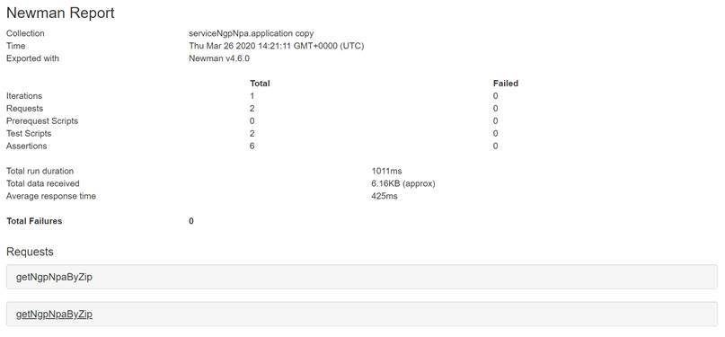
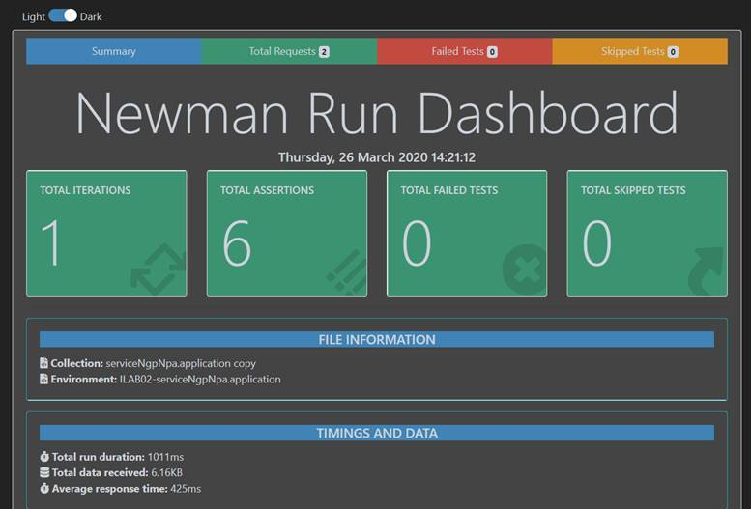
Current Scenarios
Automation test report is being generated through Newman Script currently.
1. Generating postman collection using Auto.exe file and SOAP UI to write the scenario.
2. This report is being generated for each app individually.
Notes:
Bill

Slide 4
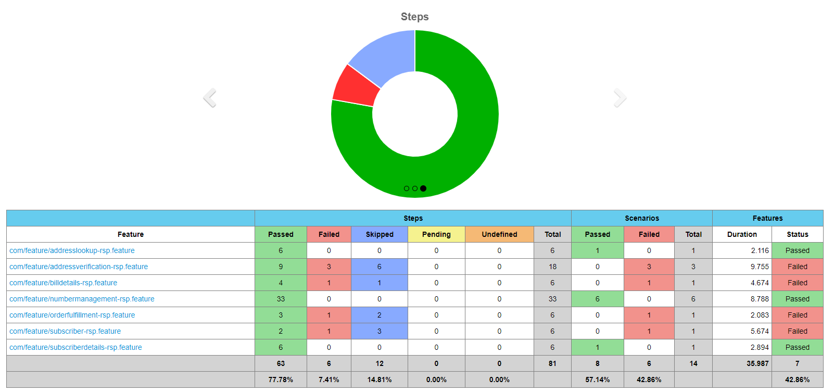
Proposed Scenarios
Karate DSL framework to generate the automation test report
Notes:
Bill

Slide 5
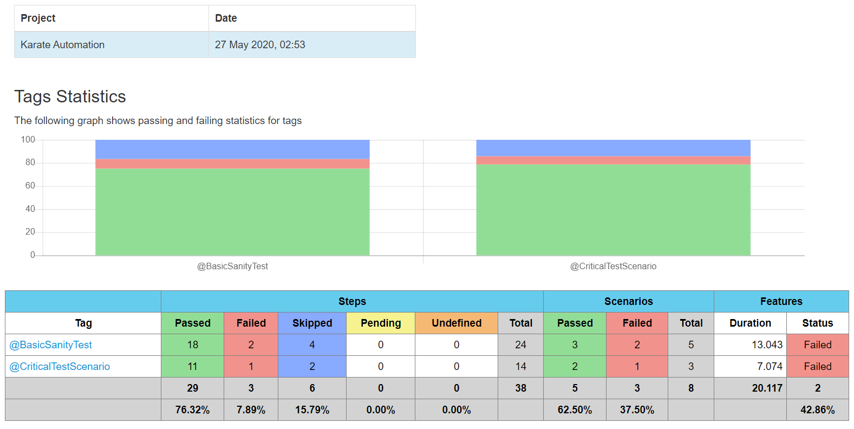
Proposed Scenarios
Notes:
Bill

Slide 6
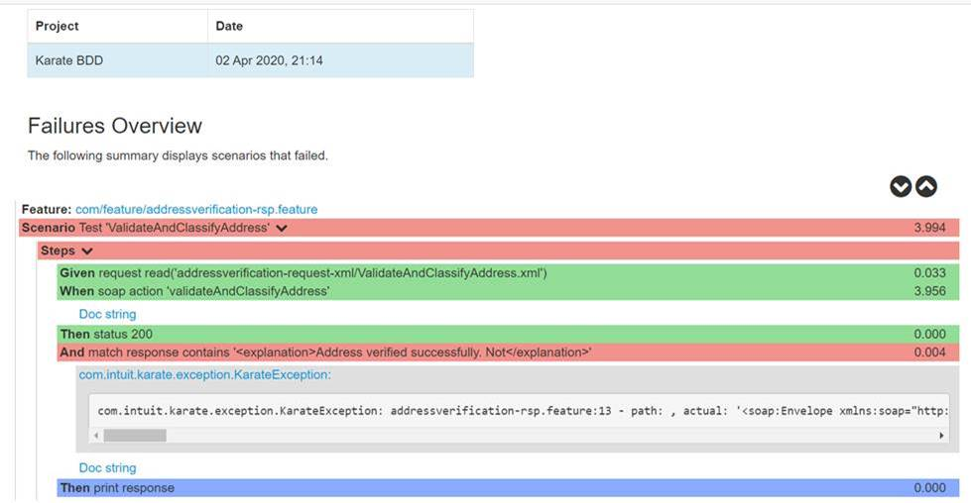
Proposed Scenarios
Notes:
Bill

Slide 7
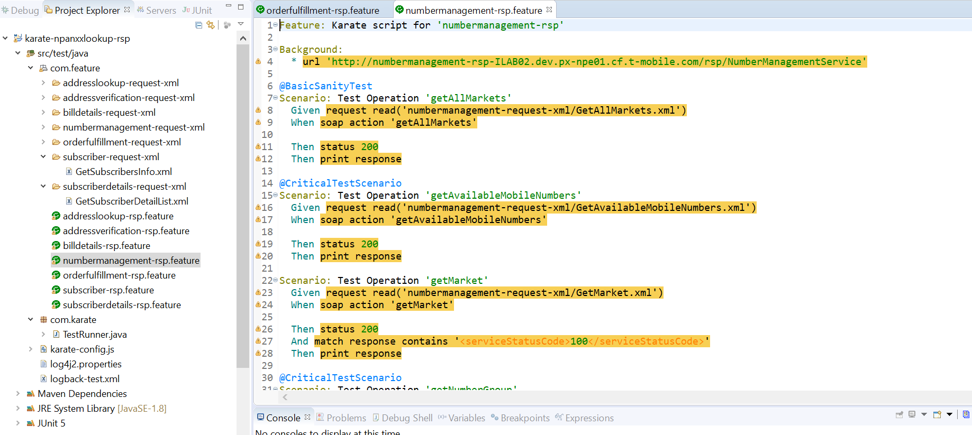
Test Case
Notes:
Bill

Slide 8

Q & A

Slide 9
Generate weekly health report for external API’s call (i.e.- SAMSON/CHUB etc.)
DSG Team

Slide 10
My Idea is…
Title: | Generate weekly health report for external API’s call (i.e.- SAMSON/CHUB etc.)
Idea Type: | Disruptive Innovation
Idea Description: | Develop application, which will generate weekly health report for all external API’s call (CHUB/SAMSON etc), which currently being used in our services to get the corresponding data(i.e.-In Charge/DFM).
Benefits: (in terms of money, effort or user experience) | Through this report, we can do the performance analysis of all external API's (Tuxedo/Chub etc.) while doing load testing, and then predict the data related issue which could come later due to service down or poor performance. And even we can suggest API’s vendor also for their hardware level upgradation, If required. QA/DEV's effort & time both would be save, because mostly the issue come on data level which is dependent external API call. But QA team directly jump to developer, and after dev analysis it come at data level which is coming through Tuxedo/Chub service call. So this report can help us to track the external service performance & save resource time accordingly. Easy to integrate on Jenkin CI/CD pipelines to automate it.
Applicable To: (project, vertical, global) | All project
Owned By: | DSG- Charge- Devesh
Note: Add slides to this presentation to provide details about the idea. Having a proof of concept/working model to demonstrate would be an added advantage.

Slide 11
Overview of health check report for external API’s call
It will generate weekly health check report for all external API’s call (CHUB/SAMSON etc) using Gatling framework, because these APIs are being used currently in our services to get the data(i.e.- Charge/DFM) and mostly the issue come at these data level.
We can do the performance analysis of external API's (Tuxedo/Chub etc.) through reports through load testing.
Current Scenarios
Currently we are not using any of the tool to generate external API’s health check reports.
Notes:
Bill

Slide 12
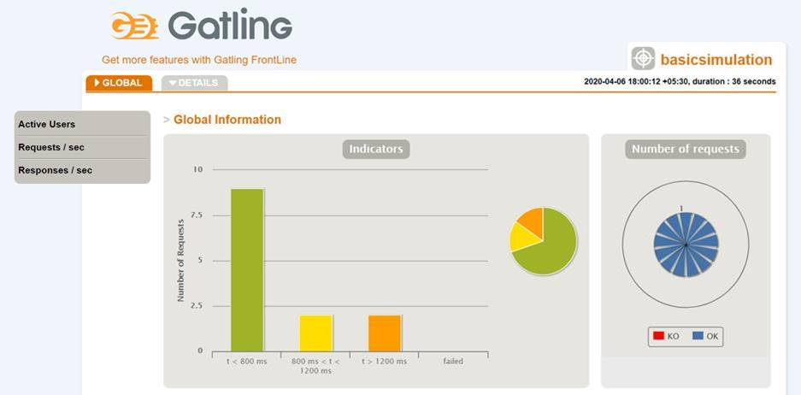
Proposed Scenario
Develop the application, which will generate weekly health report using Gatling (load & performance testing framework).
Notes:
Bill

Slide 13
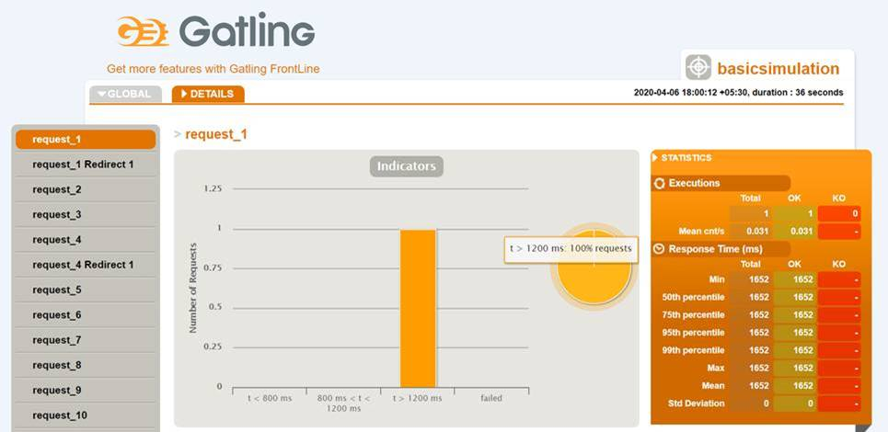
Proposed Scenario
Notes:
Bill

Slide 14
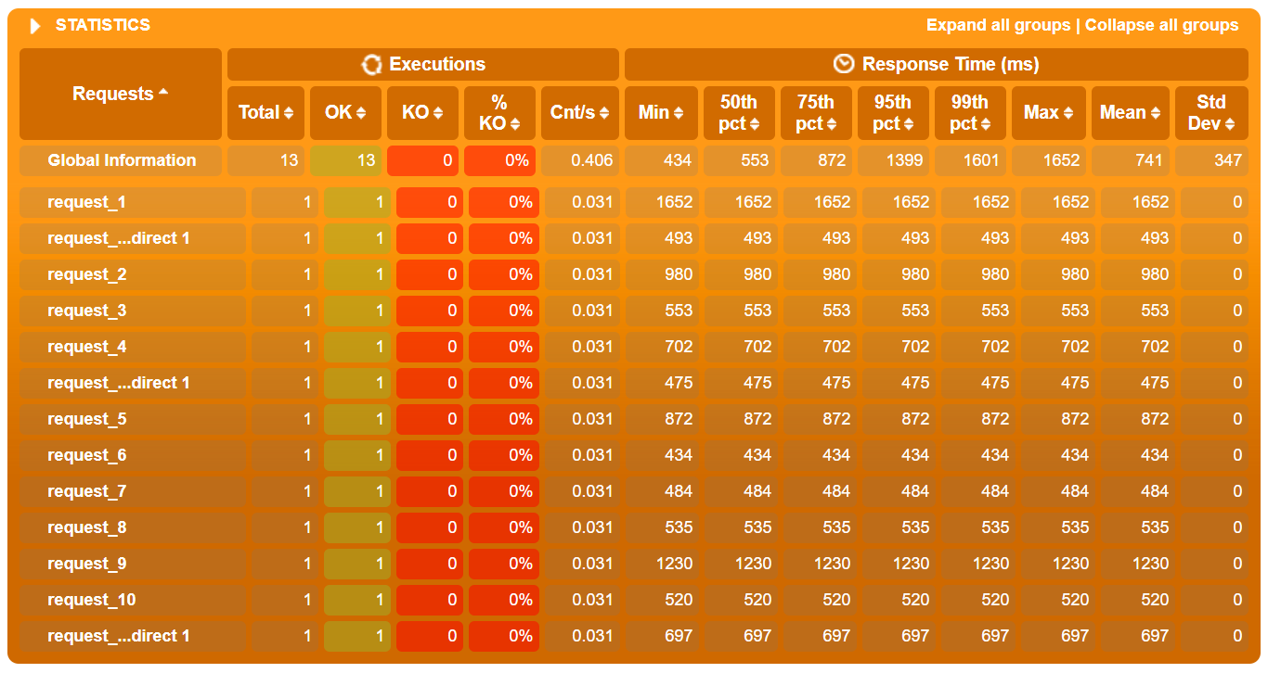
Proposed Scenario
Notes:
Bill

Slide 15
Q & A

